Slide 1
Static Forces
It’s Shocking!

Slide 2
Static Electricity Demo Video

Slide 3
Non-Contact Force
Forces that are caused by objects that are not touching are called non-contact forces. The Most common non-contact forces are
Gravity
Magnets
Static Electricity

Slide 4
What Causes Static Electricity?
Discuss your ideas with the the people at your table for what you think causes static electricity.
Think about the following as you discuss…
What evidence do you have?
How could you test your ideas?

Slide 5
Atoms

Slide 6
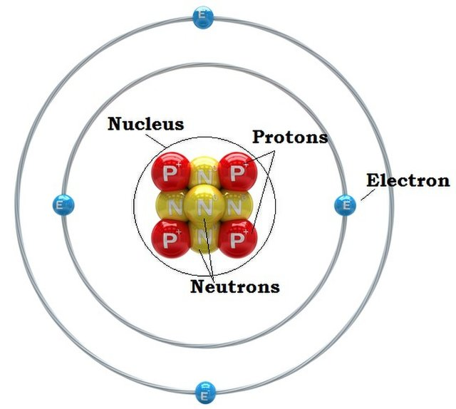
Atom parts
Protons - Positive Charge
Electrons - Negative Charge
Neutrons - No Charge (Neutral Charge)

Slide 7
“Keep it together man!”
What holds the parts of an atom together?

Slide 8
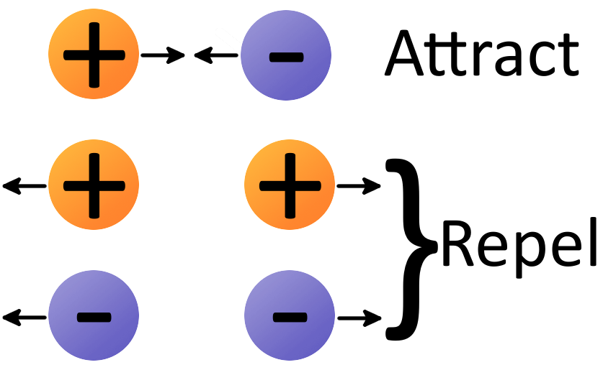
Opposites Attract

Slide 9
CER Sheet
Phenomenon: Behavior of charged and uncharged materials
CCCs: Cause and Effect
Question about phenomenon: How does the material used affect the amount of static electric charge buildup?
Evidence from data and observations: Record some of your observations from the labs on pages 1 and 2,5. These should be your evidence.
Reasoning: Use what is in your notes so far about static electricity and connect it to your evidence. Also we will watch a video that will help with this section

Slide 10
Force Balloons: You will give them the force!
1. Answer the questions at the top under “phenomena-rubbing a balloon against your hair” at your seat right now.
2. At the stations, Blow up the two balloons (have the two best balloon people do this), then charge one balloon by rubbing the balloon a lot against your hair (if you love your hair today, rub it against the materials provided). Leave one balloon uncharged for now.
3.Recharge the balloon each time you go to a different object or surface.
4. You will charge the other balloon later.

Slide 11
Are you Strong with the Force?
The balloon and water:
Take one of your balloons and charge it up really well. Turn on a stream of water at the tap (slow low stream) and bring the balloon next to the water stream. Write down observations you have and then record questions you have about the observations.
Answer the questions that follow.

Slide 12
Bubble races

Slide 13
Opposites Attract Phet
On the iPad play around for a few minutes with a simulation that demonstrates this principle
Go to the Phet app. The click on Balloon and Static Electricity. You can charge the balloon by rubbing on the sweater.
If you are doing this on a computer click the link above.
As you are doing it answer this question...
How does an Atom become Positive or Negative?

Slide 14
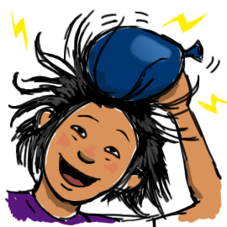
How does an Atom become Positive or Negative?
If an atom does not have tightly bound electrons. The electrons can be pulled or pushed off of the atom onto another object.
You have experienced this when you shuffle your feet in socks across the carpet, or when you rub a balloon in your hair.

Slide 15
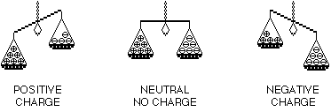
Movement of Electrons
Most atoms are neutral in nature, meaning they have the same number of protons and electrons.
An object that gains electrons is now negative because it has more electrons than protons.
An object that loses electrons is now positive because it has less electrons than protons

Slide 16
A Shocking realization.
When you shuffle your stocking feet (feet in socks) across the floor and then touch a doorknob, what cause the shock?
On the iPad play around for a few minutes with a simulation that demonstrates this principle
Go to the Phet app. The click on John Travoltage. You can manipulate it by moving his leg and arm.
If you are doing this on a computer click the link above.

Slide 17
Hear from Bill Nye...

Slide 18
The Strength of Static Force
Discuss with the person next to you…
What do you think determines the strength of a static force?
How could you make objects produce a stronger static force?

Slide 19
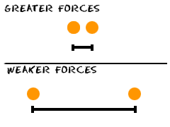
The Strength of Static Force
There are two main ways to change the strength of a static force.
The first one distance. The closer the objects the stronger the force between the objects.

Slide 20
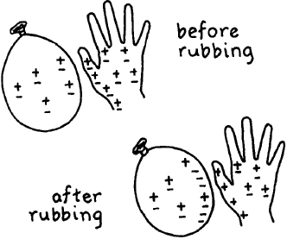
The Strength of Static Force
The second way to affect the strength of static forces is by the charge of the object.
The Charge is determined by how many electrons an object has compared to how many protons an object has.

Slide 21
Example
If an object has 10 electrons and 5 protons, the charge would be -5 (remember electrons are negative).
-10 + 5 = -5
If an object has 5 electron and 5 protons there is no charge.
-5 + 5 = 0
If an object has 5 electrons and 7 protons it would have a +2 charge (remember protons are positive).
-5 + 7 = +2
The greater the charge the stronger the force can be.

Slide 22
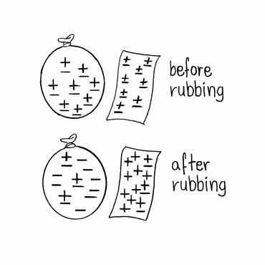
What is the Charge of the Balloon?
Before = 0
After = -8

Slide 23
Review Video

Slide 24
Review Question
You give two balloons positive charges by rubbing them against your hair. If you want to increase the amount of force the balloons apply on each other when sit on the desk. What can I do?

Slide 25
Review Question Answer
You could have said…
Bring the balloons closer together
Or
Increase the charge of the balloon (by rubbing the balloon more on your head).

Slide 26
CER sheet page 9
Phenomenon: Behavior of magnets
CCCs: Cause and Effect, Structure and Function, Patterns
Question about phenomenon: What affect do the poles of a magnet have on attraction or repulsion (they do not attach)?
Evidence: Use the magnets in different ways and try to connect them end to end and side to side. Lay out the paperclips on the station in one spread-out area and then lay the magnet on top of them to see where most of them attach to the magnet. Record your observations as evidence.
Reasoning: Try to explain your observations in terms of what you already know and what we have learned so far.
Claim: Make a claim about how the magnets are working.
Explanation: Tie in your claim to the evidence and reasoning.

Slide 27
Compass Observations 1st part, 2nd part read instructions
Using your compass, observe how the needle moves when you turn the compass around one full rotation. Record your observations
With your compass, try pointing it in different directions on the station and then record where the needle goes under observations
In the question section, record at least one question you have about the compass and how it works. Any questions will work.
Next, take one bar magnet and begin with the north or south pole and bring it close to the compass needle and move the magnet all the way around the needle

Slide 28
Compass observations continued
Try again with the south pole of the magnet this time. Record observations
Ask a question that has to do with your observations. Any question about what you are observing will work.

